Slide 1
Lightning Round IV:
International Updates
Daniel Gajewski
December 10, 2020

Slide 2
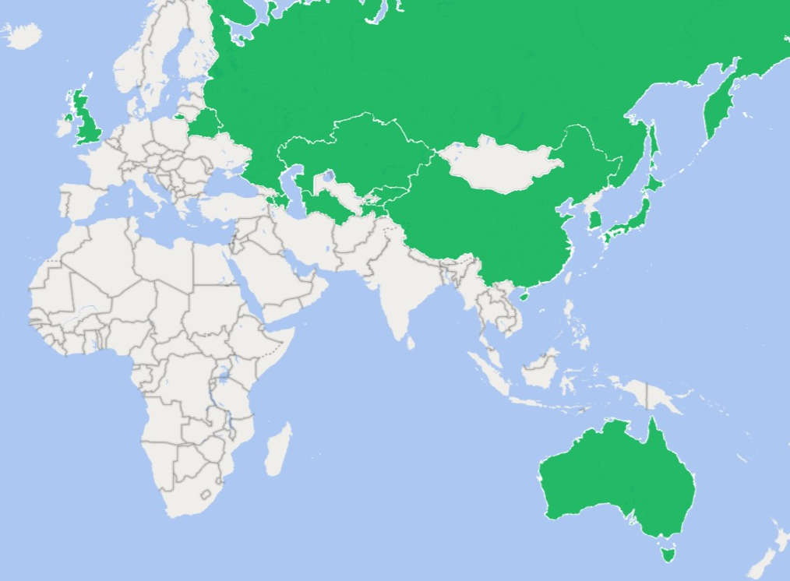
What’s New?
Hague
China
Japan
South Korea
United Kingdom
Australia
Eurasia

Slide 3
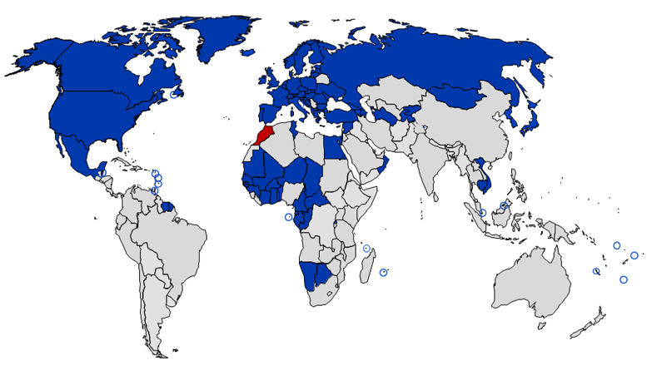
The Hague System and Contracting Parties
74 total Contracting Parties as of September 15, 2020
Recently joined
  San Marino and Viet Nam (2019)
  Samoa, Israel, and Mexico (2020)
Keep watching for China

Slide 4
China
Design patent law updates go into effect June 1, 2021
  Partial Designs Permitted
    GUI designs will no longer need to be tied to a particular device
  Term extended to 15 years from date of application
  Damages increases

Slide 5

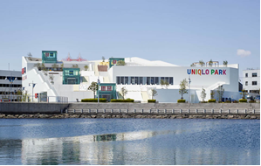
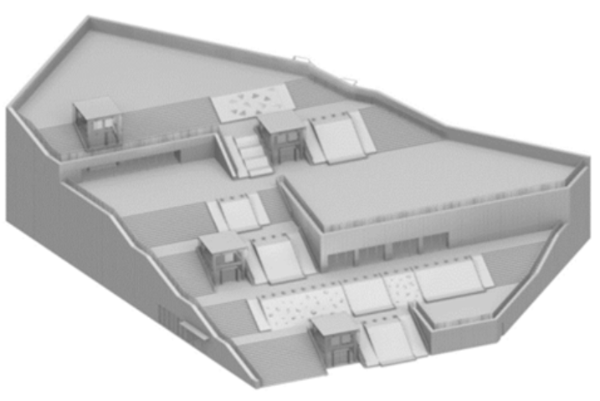
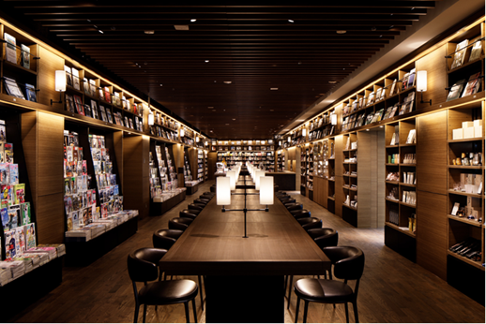
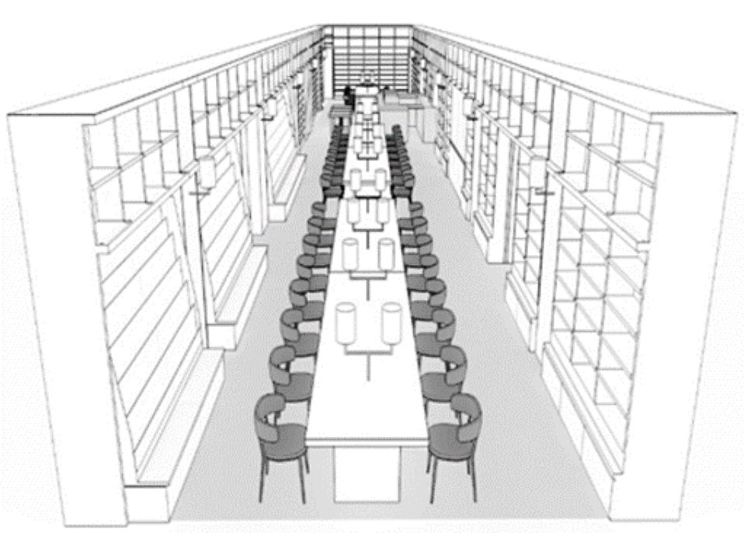
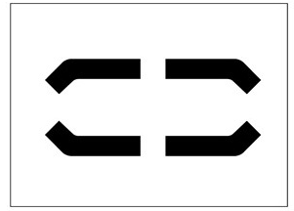
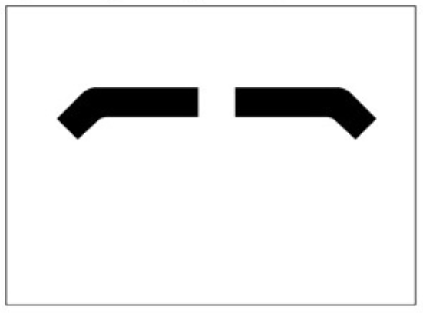
Japan
Revised Design Act came into effect April 2020
  GUI can be protected independent from a device
  Buildings and interior design can be protected
Related design practice expanded
  10-year period for a related design
  Related designs can relate to the principal design or another related design
Japan Design Registration No. 1672383: “Graphic Image for Displaying Information on Situation of Vehicle”
Japan Design Registration No. 1671773: “Commercial Building”
Japan Design Registration No. 1671152: “Book Store Interior”

Slide 6
South Korea
Expanded non-substantive examination
  Designs for food, travel goods, packaging, and adornment will no longer be substantively examined
    Joining clothing/fashion, fiber/fabrics, office supplies
  Faster examination (10 days to 3 months)

Slide 7
United Kingdom
Brexit!
As of January 1, EU design registrations (RCDs) will no longer be effective in the UK
On January 1, the UKIPO will automatically create cloned UK rights for EU RCDs
  Unpublished RCDs will not be automatically cloned
  Cloned UK rights will be subject to UK annuity payments
For EU design applications still pending on January 1, there will be a 9-month period to re-file as a new UK application

Slide 8
Looking ahead:
Australia
  Designs Amendment Bill 2020 was introduced December 2
    Introducing a general grace period (12 months)
    Allowing 6-month deferred publication
    Expanding prior user rights
Eurasia
  The Eurasian Patent Organization (EAPO) is developing a Eurasian design patent system
    EAPO member countries: Armenia, Azerbaijan, Belarus, Kazakhstan, Kyrgyzstan, Russia, Tajikistan and Turkmenistan
  Some EAPO member countries have begun to ratify

Slide 9

Daniel A. Gajewski
Director
Sterne, Kessler, Goldstein & Fox dgajewsk@sternekessler.com
(202) 772-8447

