Slide 1
LIGHTNING ROUND III: Update on Trademark Protection for Designs
Katie Laatsch Fink

Slide 2
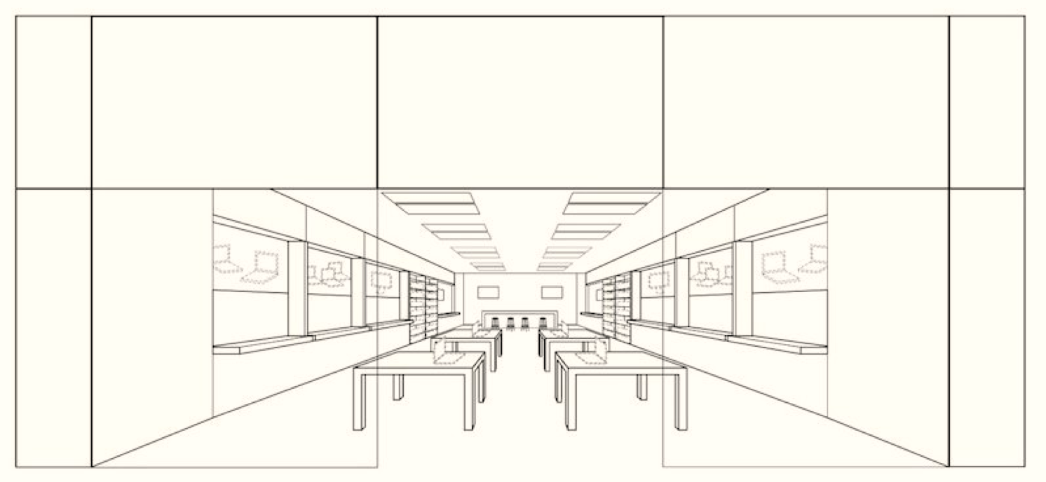
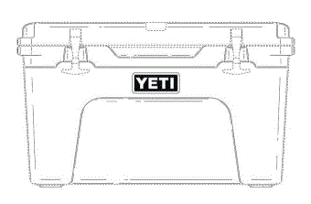
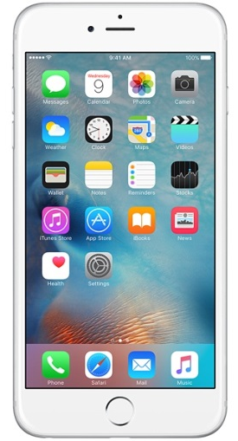
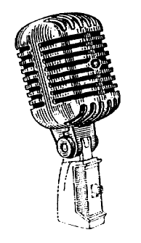
Trade Dress
Protects product designs, packaging, buildings, stores, restaurants, etc., that have acquired distinctiveness and that are non-functional
Design Law 2020

Slide 3
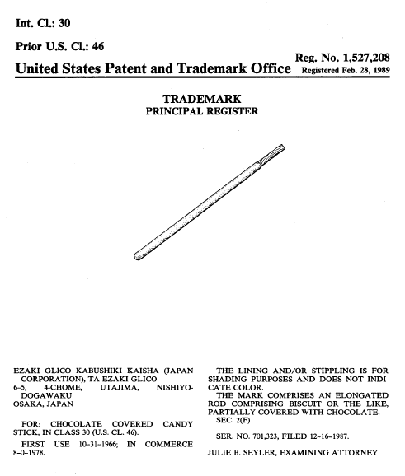
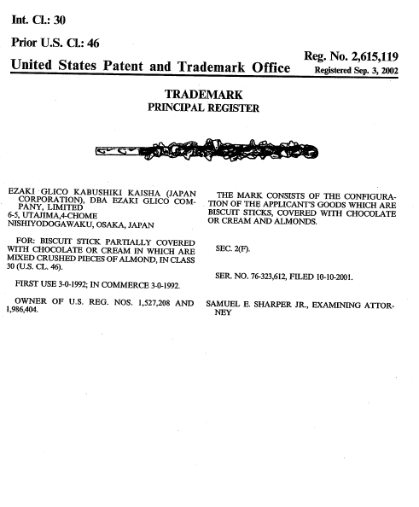
Ezaki Glico Kabushiki Kaisha v. Lotte Int'l Am. Corp.
3d. Circuit – October 2020
Ezaki Glico has made and sold Pocky sticks for over 50 years and since 1978 in the U.S.
Owns trade dress registrations for its Pocky sticks – registered in 1989
Design Law 2020

Slide 4
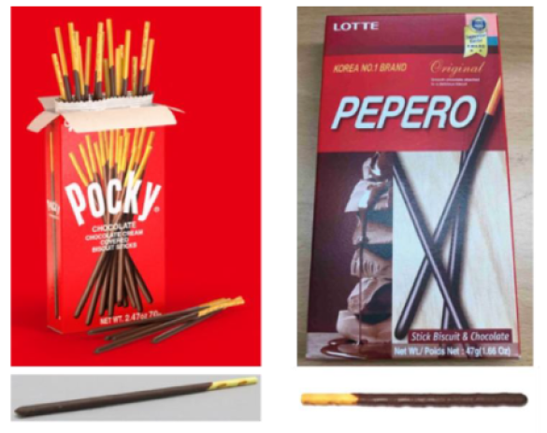
Ezaki Glico
Pocky
Lotte
Pepero
Design Law 2020

Slide 5
Case History
Pre-suit
1993-1995 – Ezaki Glico demanded that Lotte stop selling Pepero products; Lotte said it would stop selling Pepero products until dispute resolved, but resumed
For next 20 years, Ezaki Glico took no action
Ezaki Glico sued Lotte in District of New Jersey in 2015
Alleged trademark infringement and unfair competition
District Court granted summary judgment for Lotte, holding that the Pocky trade dress was functional and not protectable
Ezaki Glico appealed to the 3rd Circuit
Affirmed
Decision focused on functionality
Design Law 2020

Slide 6
3rd Cir. Opinion
Acknowledged protectability of trade dress
Trademark law can protect a product’s trade dress, which is the overall look of a product or business
Includes not only a product’s packaging, but also its design, such as its size, shape, and color
Trade dress is limited to protecting the owner’s goodwill and preventing consumers from being confused about the source of a product
But … “We are careful to keep trademark law in its lane.”
Trade dress protection is not intended to create patent-like rights in innovative aspects of product design
Even if copying would confuse consumers about a product’s source, competitors may copy unpatented functional designs
Design Law 2020

Slide 7
Key Dispute: Meaning of Functional
Ezaki Glico argued it means “essential”
The court held it means “useful”
Webster’s Dictionary, Qualitex, TrafFix, Wal-Mart, McCarthy on Trademarks, and others
Evidence helpful to prove functionality
Evidence that shows a feature or design makes a product work better
It is strong evidence of functionality if a product’s marketer touts a feature’s usefulness
A utility patent is strong evidence that the features claimed are functional
If there are only a few ways to design a product, the design is functional. Evidence of other workable designs is not enough to make a design non-functional.
Design Law 2020

Slide 8
Holding: Pocky Trade Dress is Functional
Design makes it work better as a snack
Uncoated part of biscuit allows for eating without getting chocolate on hands
Stick shape makes it easy to hold and allows for packing many sticks in each box
Ezaki Glico promotes utilitarian advantages
Ezaki Glico promotes the convenient design, no mess handle, and portability
Alternative designs do not make design non-functional
9 examples of other partly-chocolate-coated snacks that do not look like Pocky sticks are not dispositive of non-functionality
Utility patent irrelevant here
Ezaki Glico’s utility patent for manufacturing methods irrelevant because it does not overlap with claimed trade dress
Design Law 2020

Slide 9
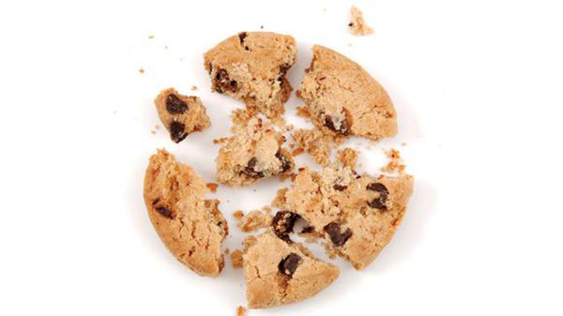
“That’s the way the cookie crumbles”
Design Law 2020

Slide 10
Not Discussed?
De Facto vs. De Jure Functionality
De facto functionality:
The design has function
May be protectable
De jure functionality:
The product is in this particular shape because it works better in this shape
Essential to use or purpose or affects the cost or quality
Not protectable
Laches – not at issue for purposes of the appeal
Design Law 2020

Slide 11
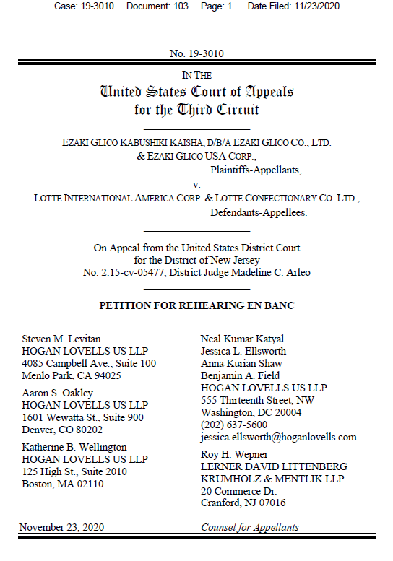
Stay Tuned…
Ezaki Glico filed a petition for rehearing en banc with 3rd Cir.
Decision is contrary to Supreme Court precedent
The court applied an incorrect standard for non-functionality
Amicus briefs filed by INTA, National Confectioners Association, Modelez Global LLC
Design Law 2020

Slide 12
Katie Laatsch Fink
(312) 463-5470
kfink@bannerwitcoff.com

